Slide 1
Team Joint Report
May 16 (Fri) 2025
Masaki Satoh, Tomoki Ohno, Chihiro Kodama, Shao-Yi Lee, Kohei Yamasaki, Chao-An Chen, Kosei Ohara, Masahiro Watanabe, Ray KUO, Shao-Yu Tseng, Yu-Hsuan Fan, Pin-Yu Chao, Hisashi YASHIRO, Shuhei Matsugishi, Chie Yokoyama, Takahashi Kotaro, Aihisa KAMIJO

Slide 2
Name: a short title
A brief description
here is a template

Slide 3
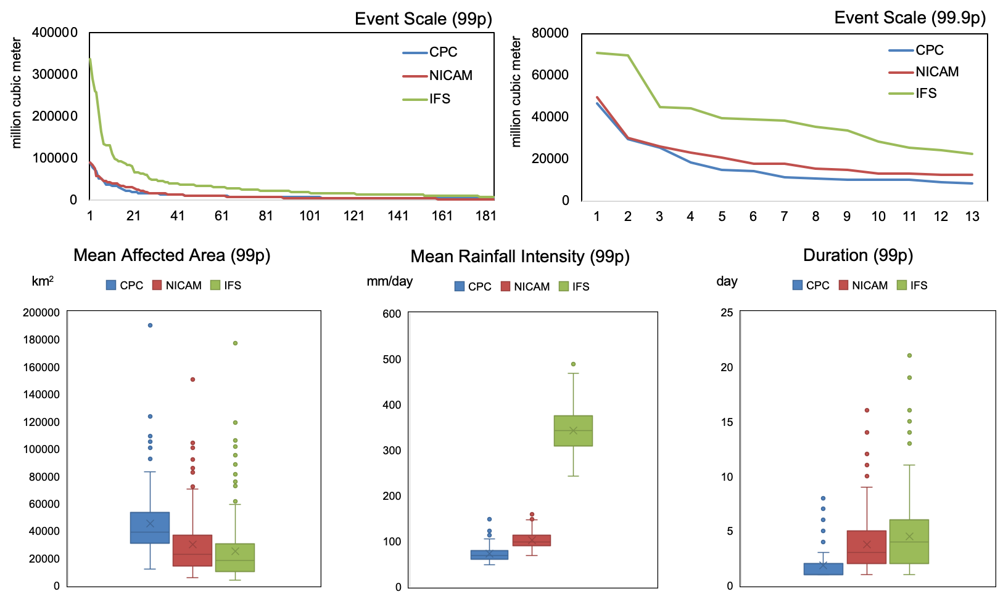
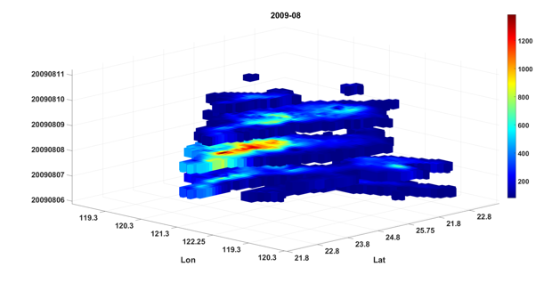
Pin-Yu Chao: Characteristics of Extreme Precipitation Event in WNP

Slide 4
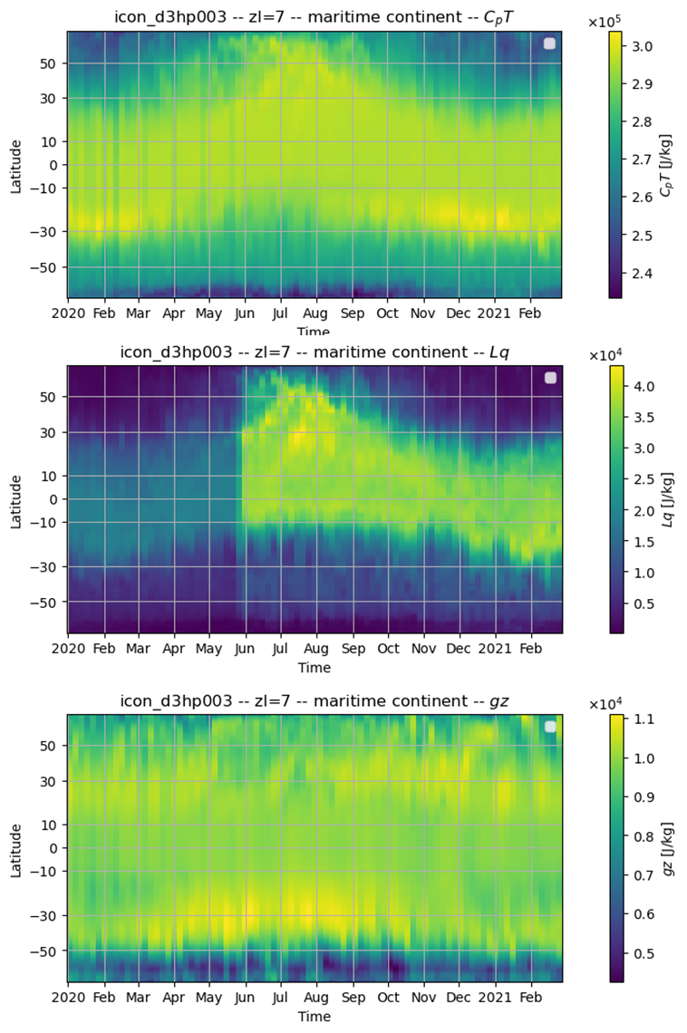
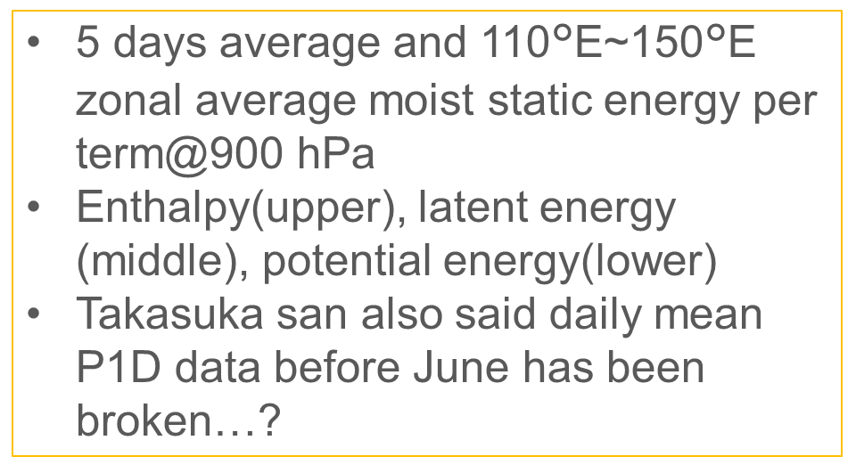
Kotaro Takahashi : ICON P1D specific humidity data(hus) before June is broken?

Slide 5
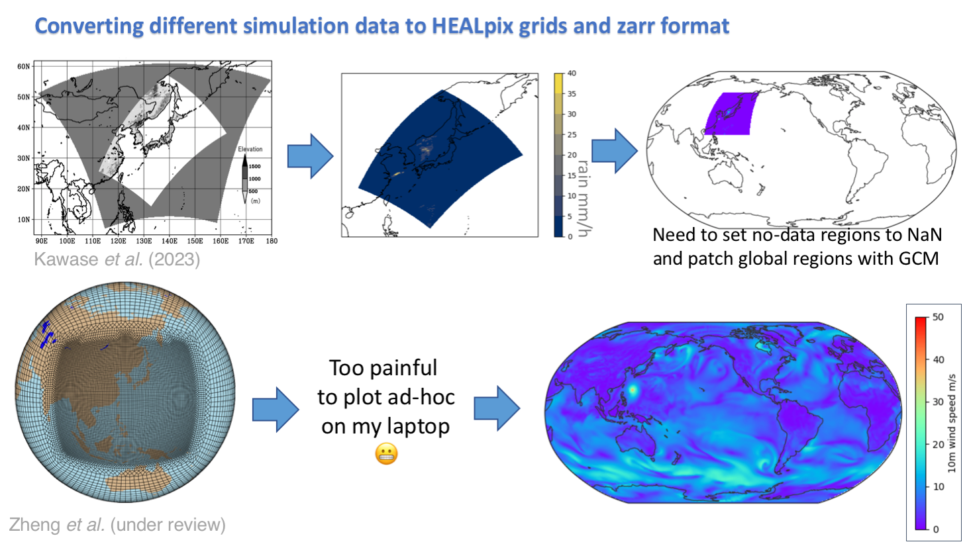
Converting different data to HEALpix and zarr
Shao-Yi Lee

Slide 6
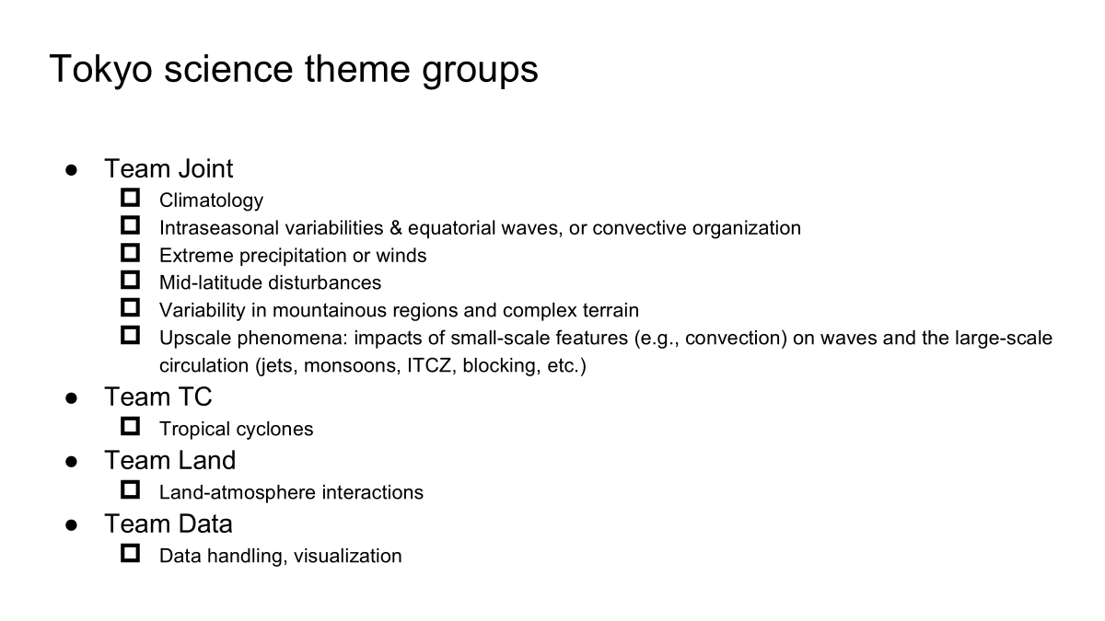
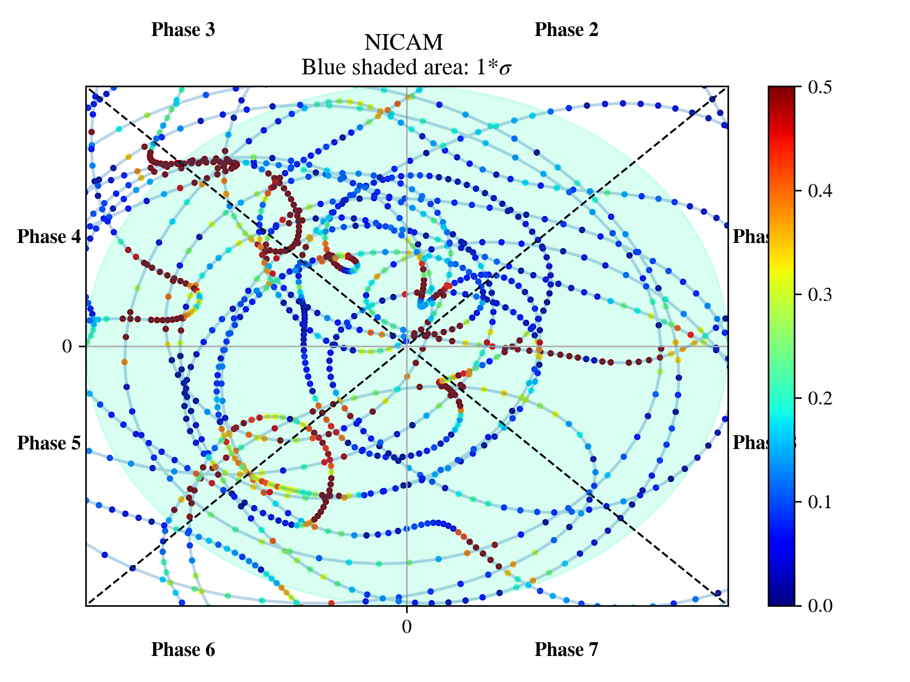
Nonlinearity
Ray Kuo
it seems that the nonlinearity
still need the strength large
enough to trigger the linear
wave outside the circle

Slide 7
Team Joint Report
May 15 (Thu) 2025
Masaki Satoh, Tomoki Ohno, Chihiro Kodama, Shao-Yi Lee, Kohei Yamasaki, Chao-An Chen, Kosei Ohara, Masahiro Watanabe, Ray KUO, Shao-Yu Tseng, Yu-Hsuan Fan, Pin-Yu Chao, Hisashi YASHIRO, Shuhei Matsugishi, Chie Yokoyama, Takahashi Kotaro, Aihisa KAMIJO

Slide 8
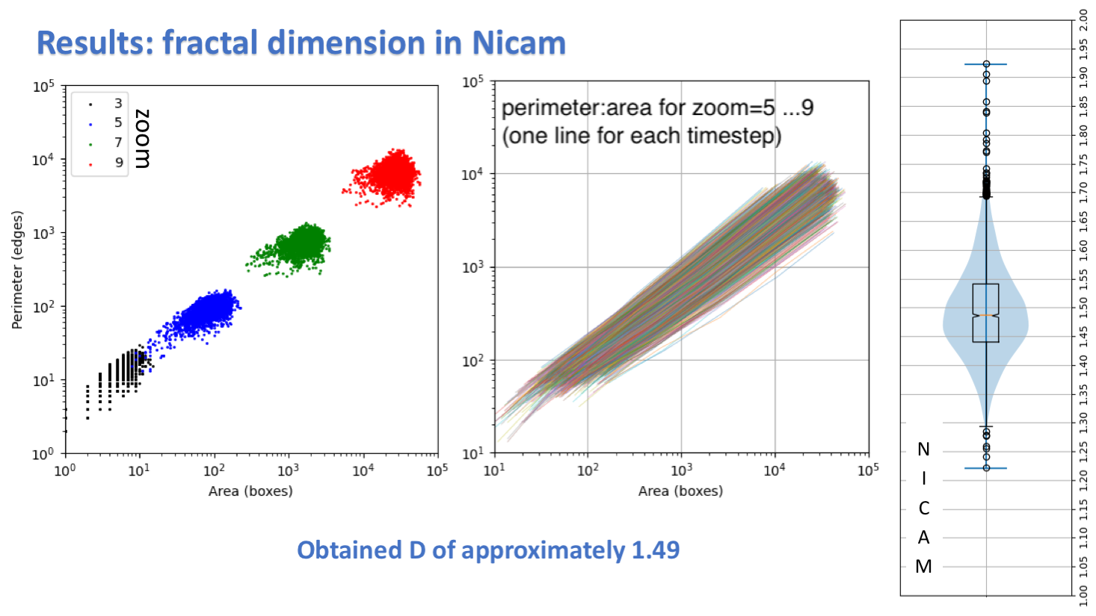
Cloud fractal dimension in NICAM
Found dimension D of approximately 1.49
over (120-150E, 20-50N)
Shao-Yi Lee

Slide 9
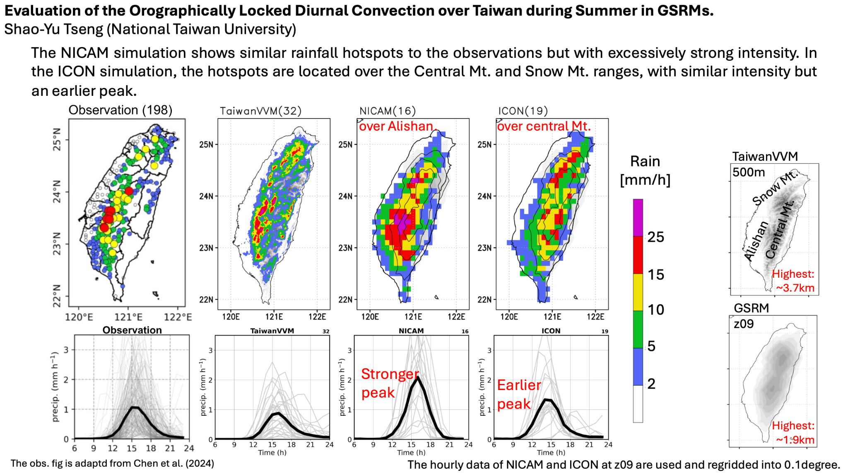

Slide 10
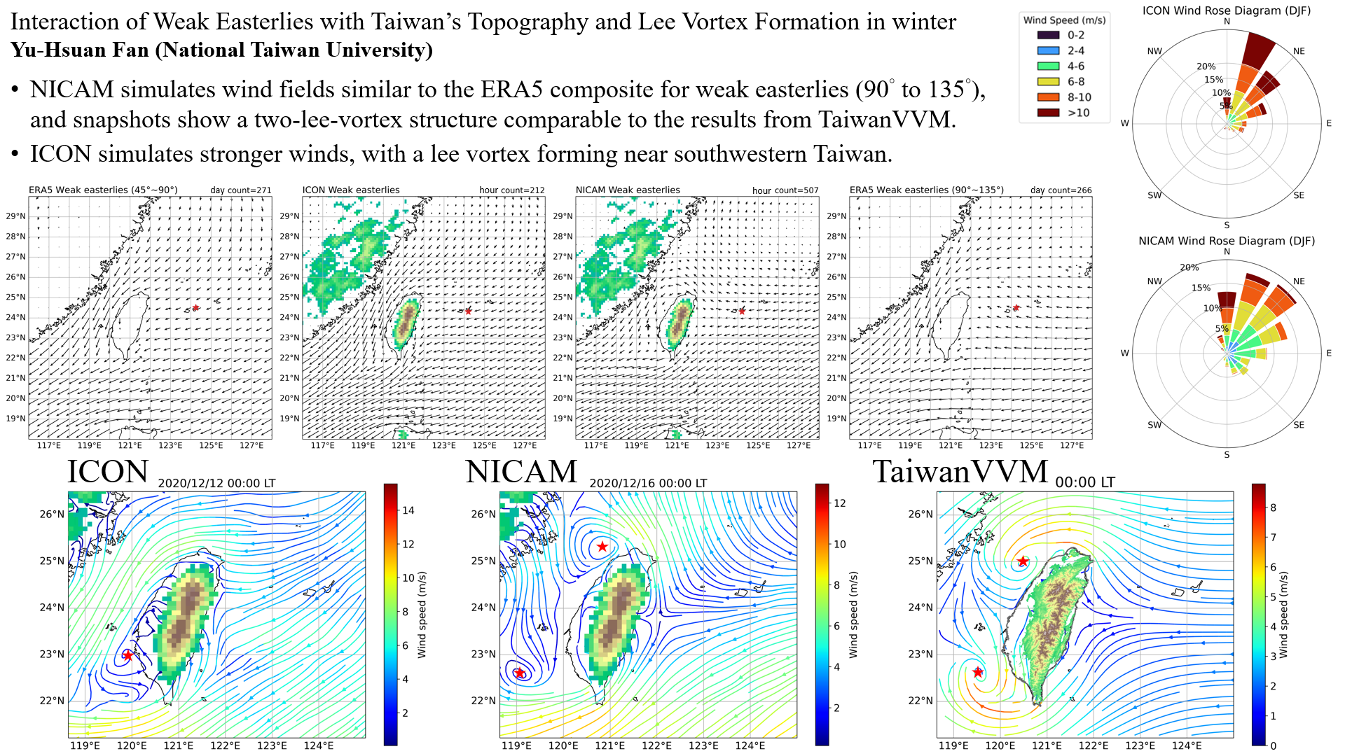

Slide 11
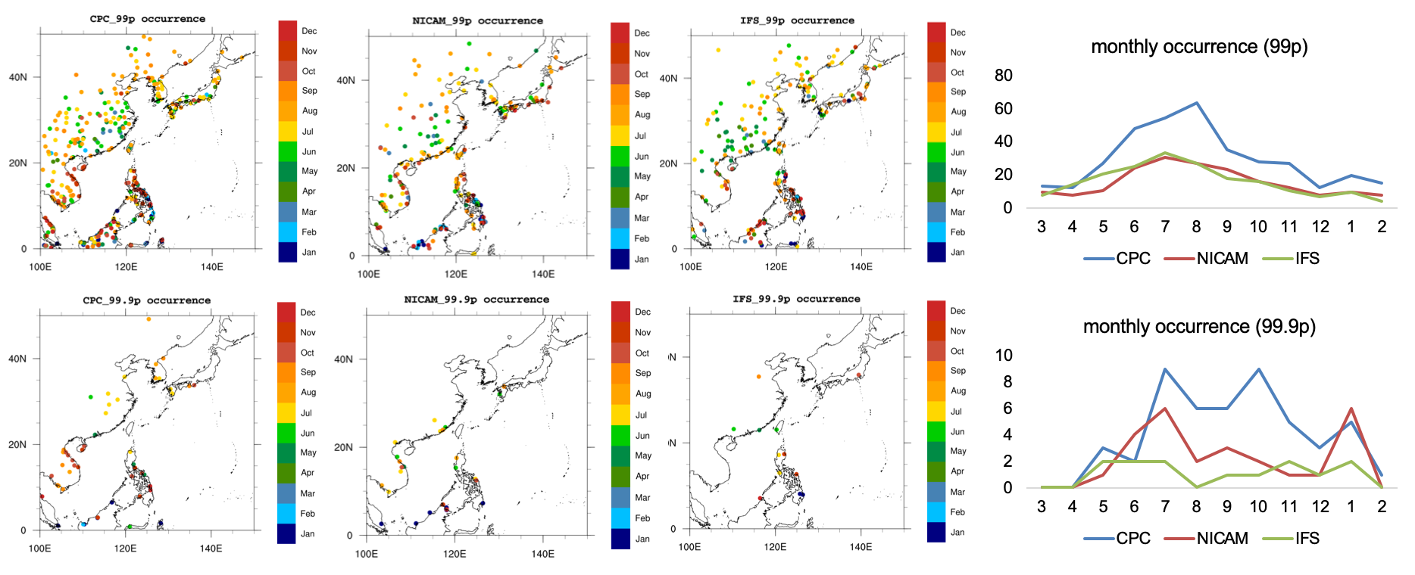
Pin-Yu Chao: Occurrence of Extreme Precipitation Event in WNP
NICAM demonstrates closer alignment with observations in both the number and location of the most extreme precipitation events (events under 99.9p threshold) over the WNP region.

Slide 12
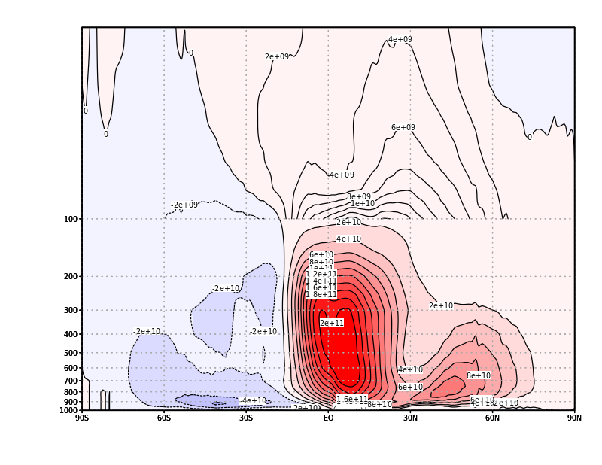
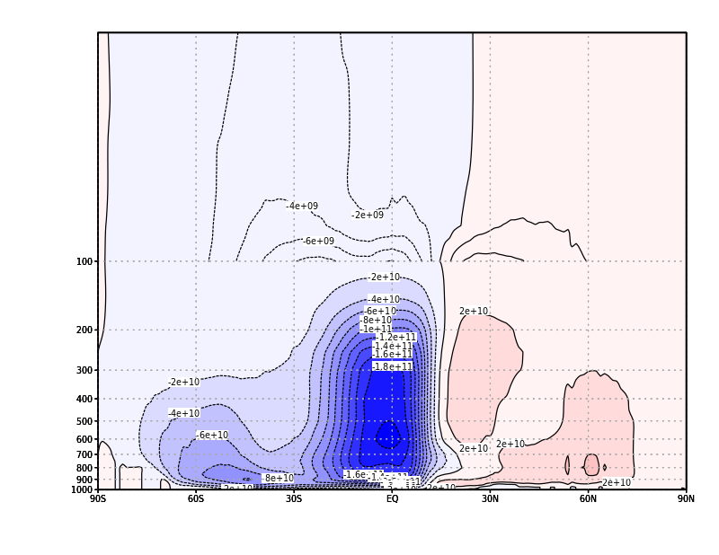
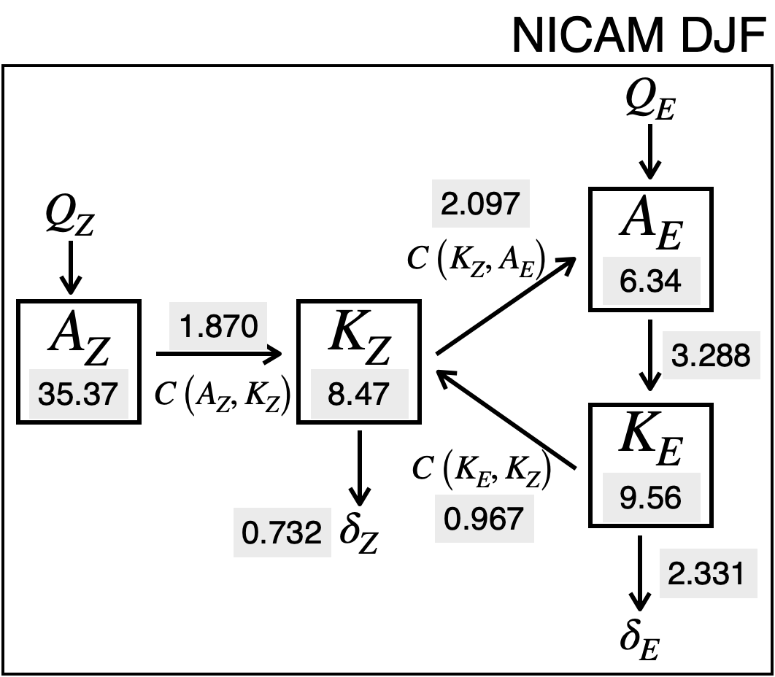

Kosei OHARA: Meridional Circulation and Energy Cycle
Meridional Circulation
DJF
JJA
mass streamfunction of meridional circulation based on isentropic analysis
Hadley circulation and Extratropical Direct (ETD) circulation are clearly shown in the winter hemisphere
Brewer-Dobson Circulation is more intense in DJF NH than in JJA SH
Energy Cycle
Energy … 10^5 J/m^2
the others … W/m^2
Ae -> Ke conversion rate is larger than in JRA-3Q … more intense ageostrophic wind
Difference of Az between two seasons is very small compared to JRA-3Q
more statistical analysis is needed, but this appears to be unrealistic

Slide 13
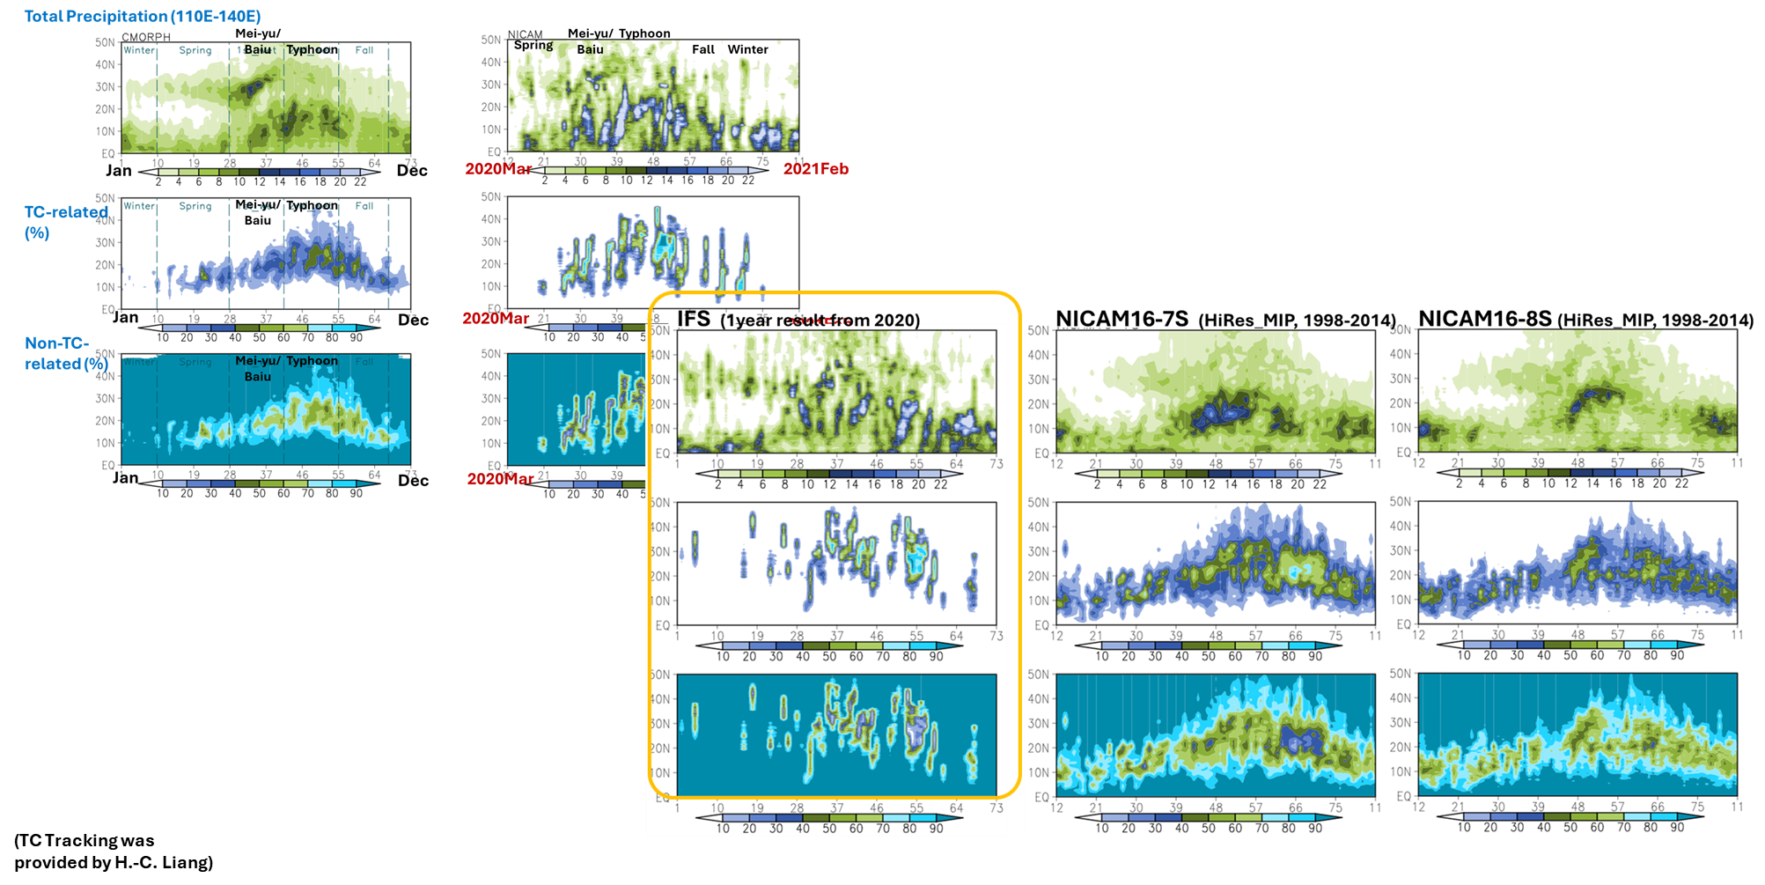
Multi-year climatology in
NICAM16-7S and NICAM16-8S : Although models perform higher amount in total precipitation, the proportion of precipitation types is comparable to observations.
Single-year results: Models tend to perform too much precipitation in total precipitation, as well as the proportion of precipitation contributed by TC.

Slide 14
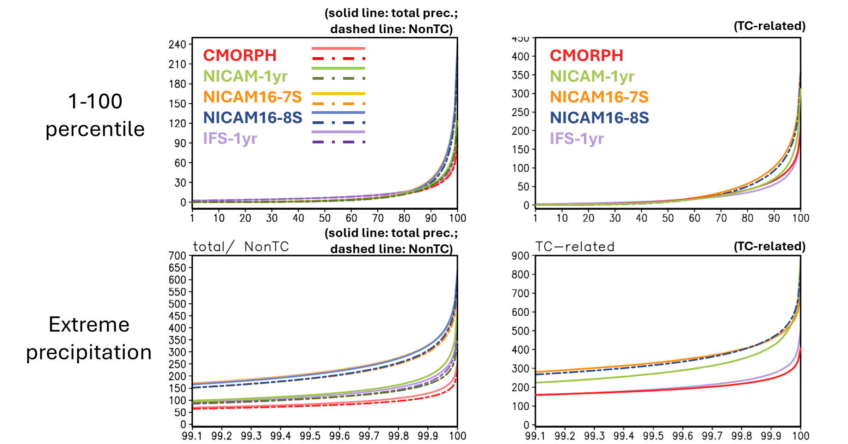
Evaluation of Extreme precipitation from the percentile perspective: NICAM matches observations in moderate heavy rainfall distribution.
For the most extreme precipitation, most models tends to overestimate the intensity.

Slide 15
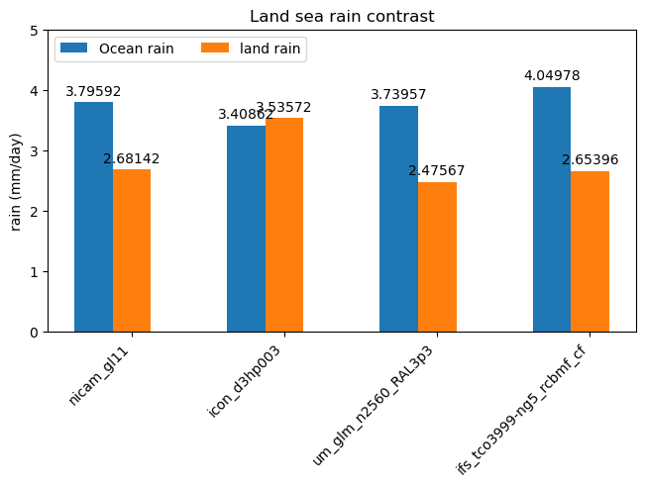
Land/Sea contrast, Diurnal cycle of Precipitaiton
Tropical (±30deg) precipitation
Shuhei Matsugishi

Slide 16
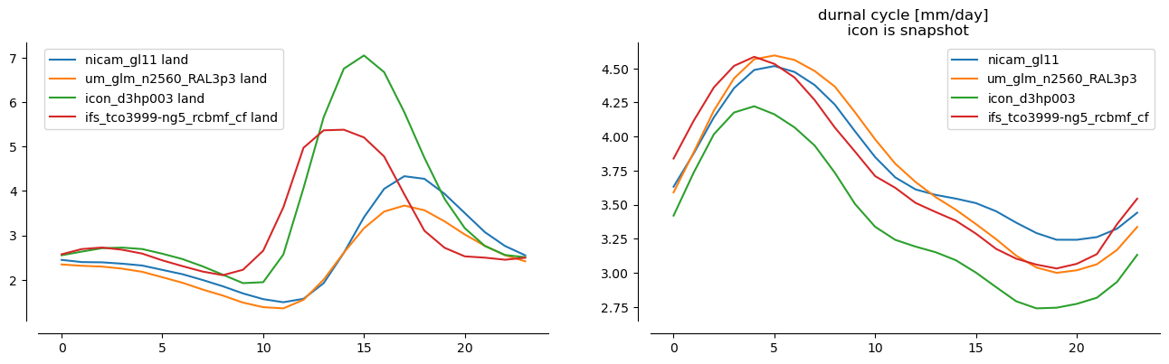
Land/Sea contrast, Diurnal cycle of Precipitaiton
Local time
Local time
Tropical (±30deg) precipitation
Shuhei Matsugishi

Slide 17
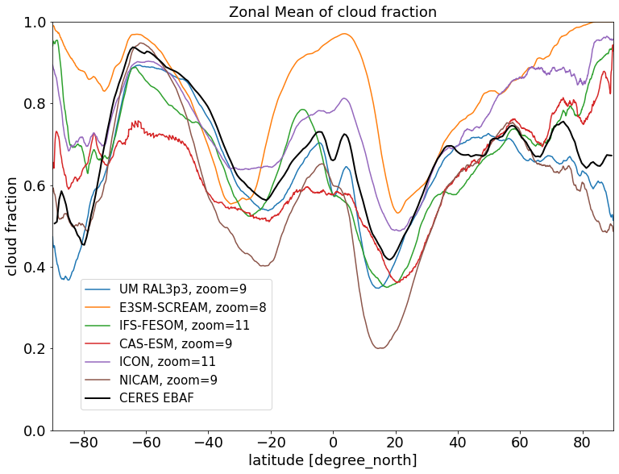
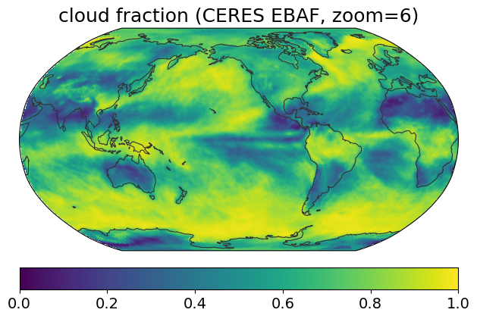
Model spread of cloud fraction (Kohei Yamasaki)
CERES EBAF (March 2020)
zonal mean cloud fraction (March 2020)

Slide 18
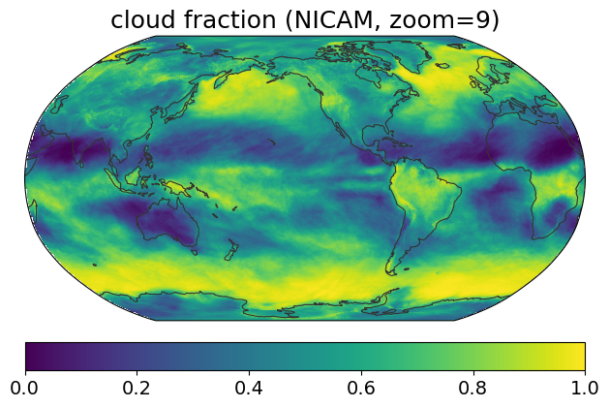
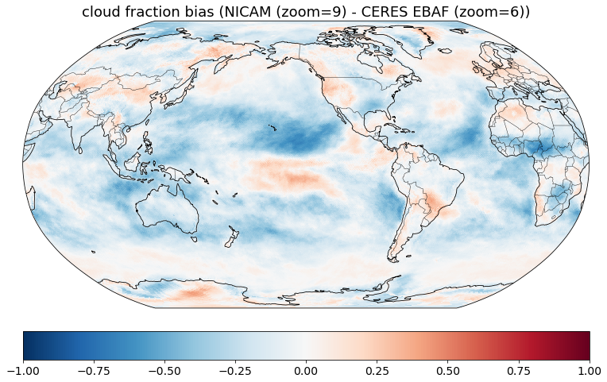
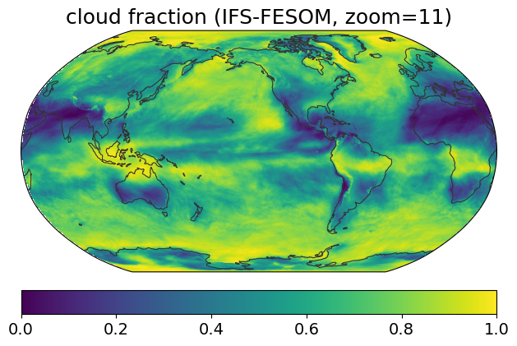
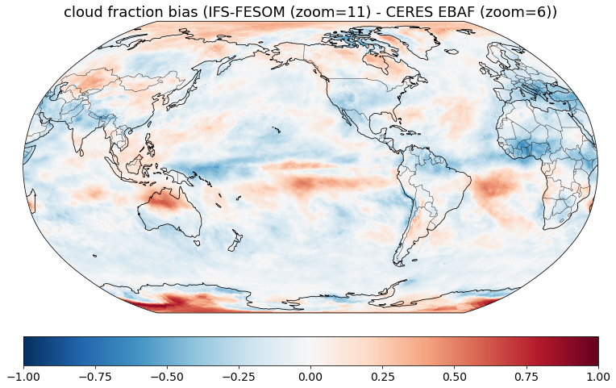
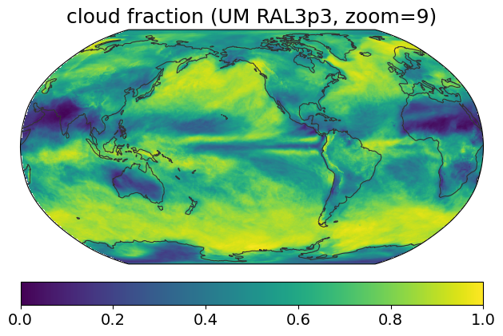
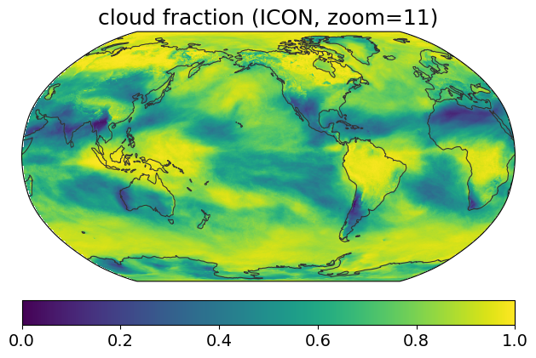
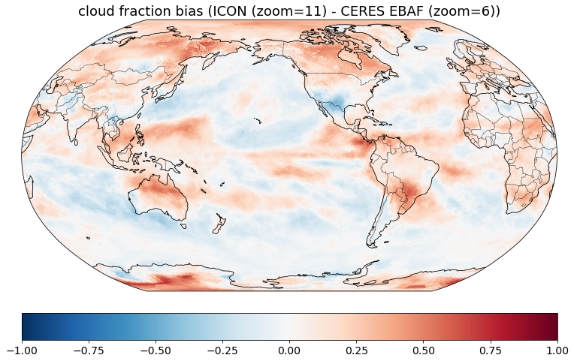
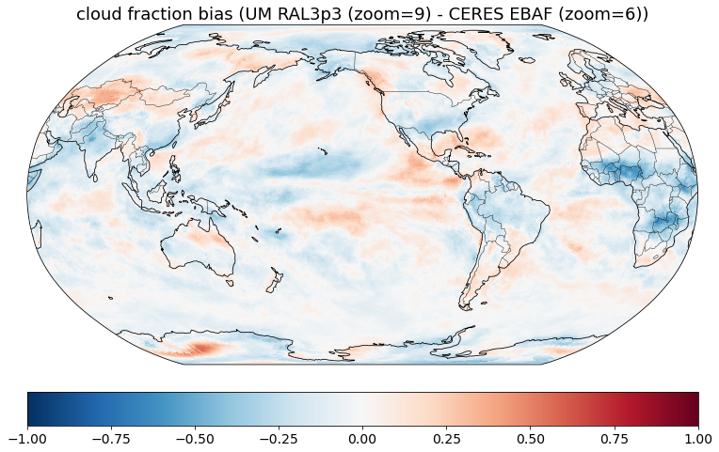
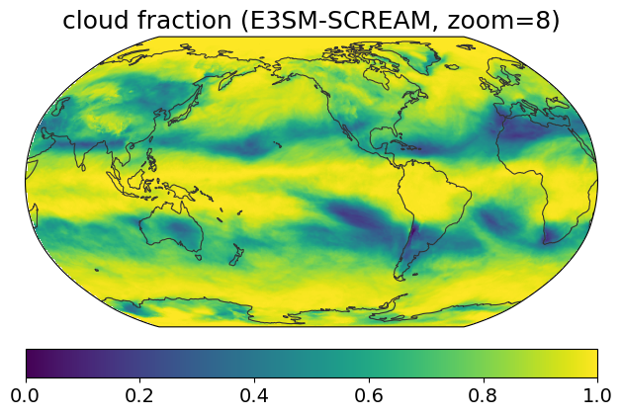
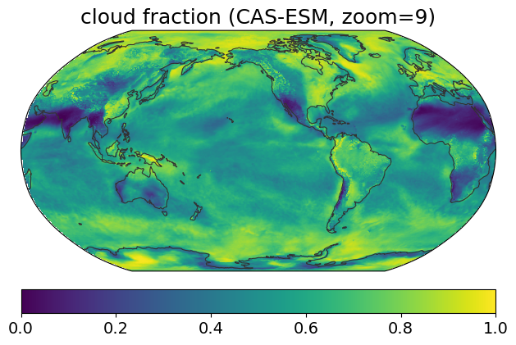
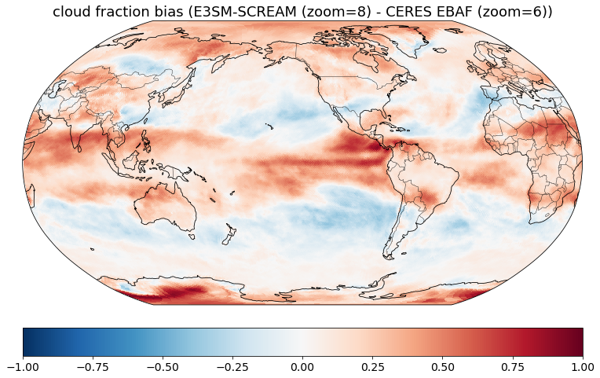
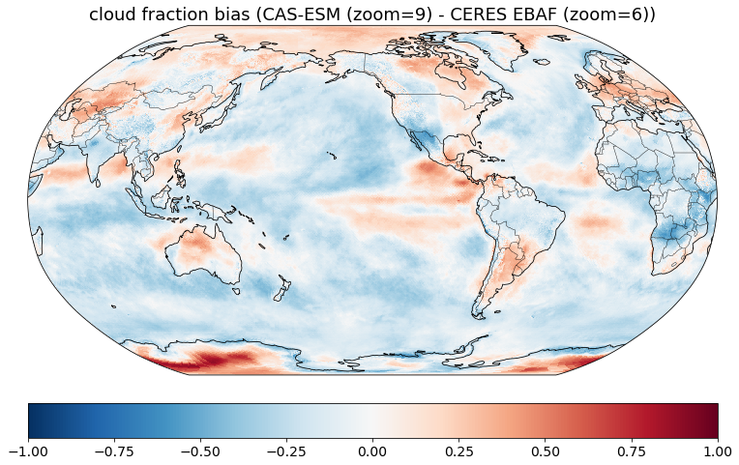
Global distribution of cloud fraction (Kohei Yamasaki)
NICAM
IFS-FESOM
UM RAL3p3
ICON
SCREAM
CAS-ESM

Slide 19
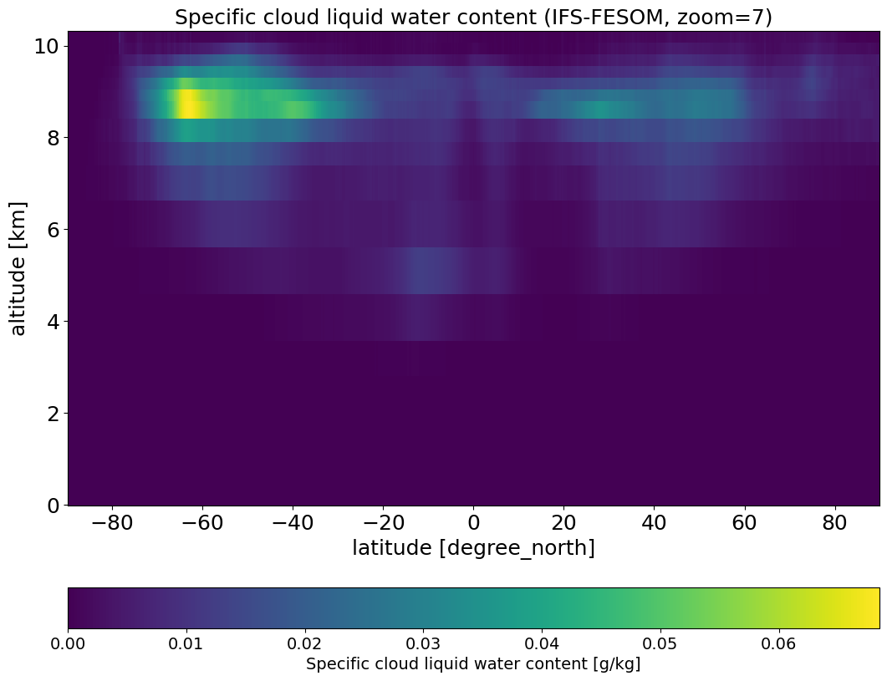
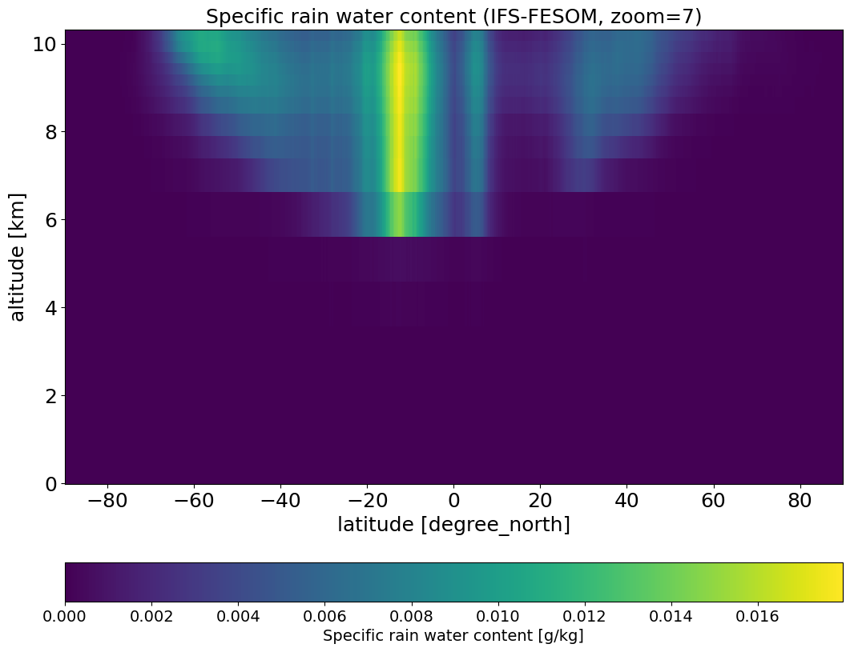
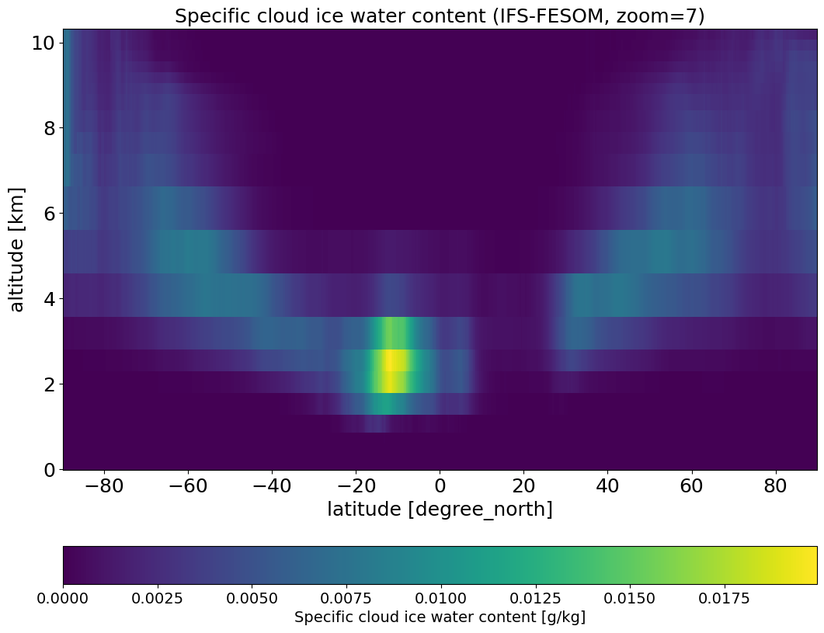
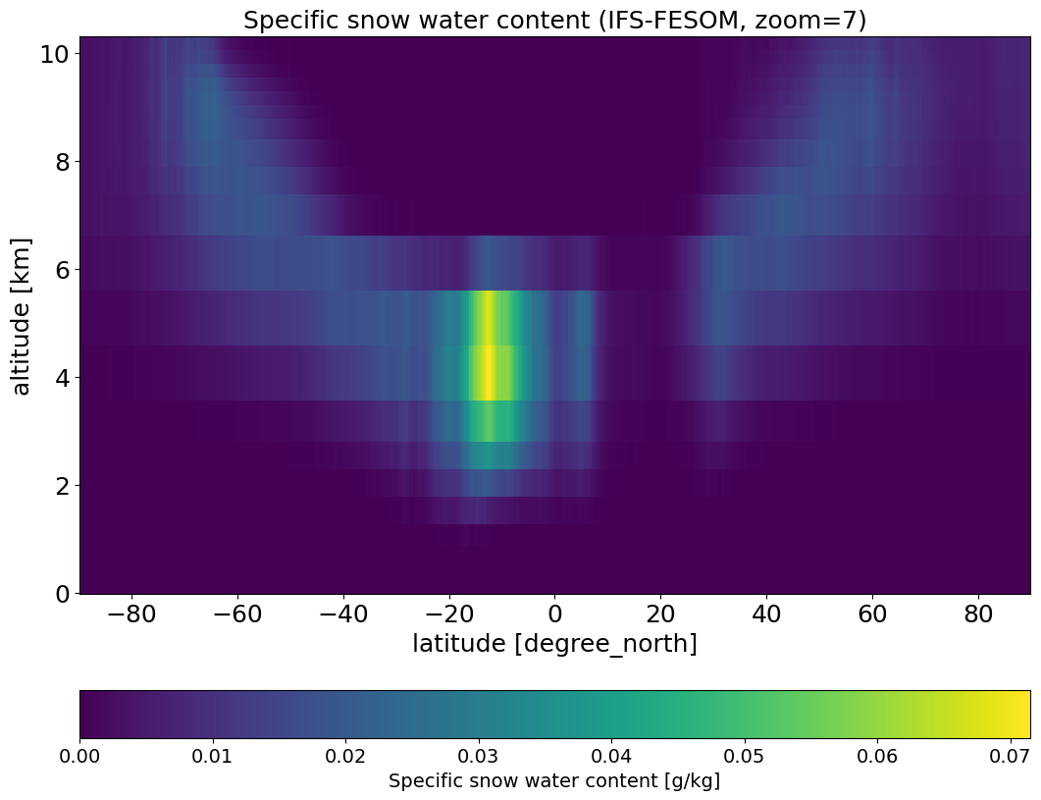
cloud water content of IFS-FESOM (Kohei Yamasaki)
liquid water content
rain
ice
snow

Slide 20
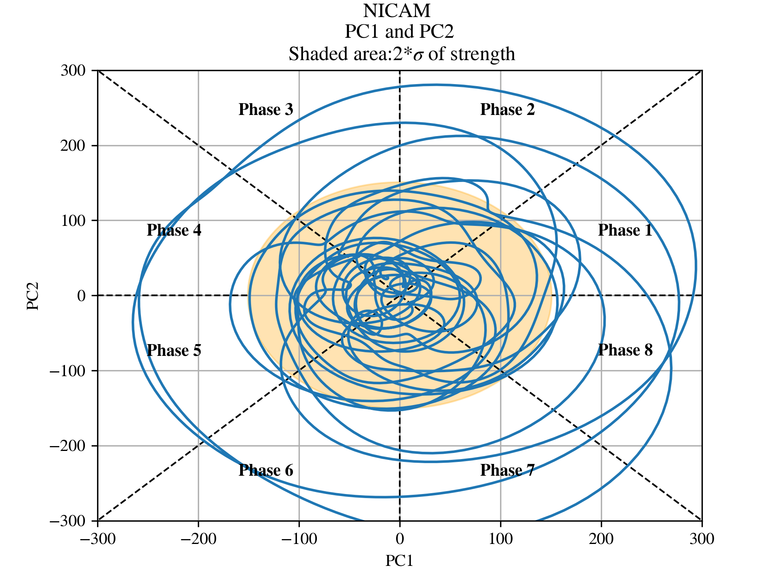
PC1-PC2 phase space of Kelvin wave in NICAM
Ray Kuo
Pretty smooth, thanks to
high resolution of time in
NICAM
One circle: One period of
kelvin wave
Strength: How far from
the origin (norm of the
vector)

Slide 21
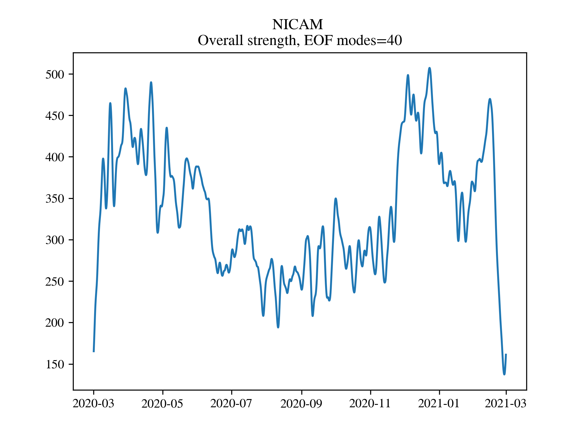
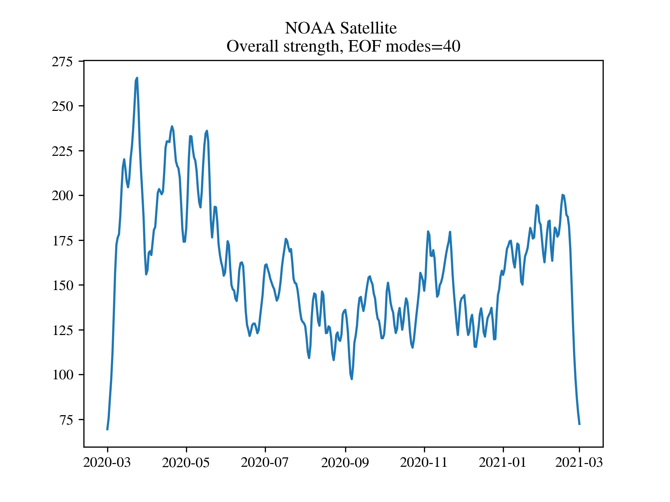
Analysis of Kelvin waves in NICAM
Ray Kuo
Seasonal cycle is good, but NICAM has weird decay in Feb.

Slide 22
Research Interests
Shao-Yu Tseng Diurnal cycle of convection/precipitation over Taiwan
Yu-Hsuan Fan Lee vortex over Taiwan, winter time
Ray KUO MJO
Shao-Yi Lee cloud fractal scale
Chao-An Chen extreme precipitation, TC -related extreme precipitation, WNP-EA monsoon
Pin-Yu Chao extreme precipitation tracking, tropical cyclone, front, MCS, ...
Ohara energy cycle
Yamasaki cloud and climatology
Takahashi monsoon, seasonal change, precipitation,
Kamijo AI, energy flux in different scale phenomena
Yokoyama MCS tracking, MSC and environment, line-shaped stationary precipitation

Slide 23
Team Joint Report
May 14 (Wed) 2025
Masaki Satoh, Tomoki Ohno, Chihiro Kodama, Shao-Yi Lee, Kohei Yamasaki, Chao-An Chen, Kosei Ohara, Masahiro Watanabe, Ray KUO, Shao-Yu Tseng, Yu-Hsuan Fan, Pin-Yu Chao, Hisashi YASHIRO, Shuhei Matsugishi, Chie Yokoyama, Takahashi Kotaro, Aihisa KAMIJO

Slide 24
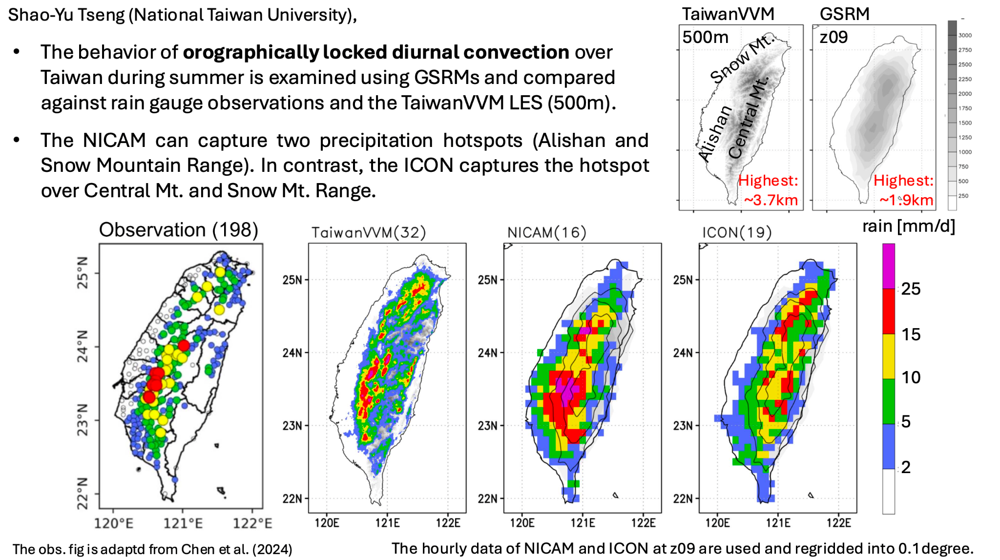

Slide 25
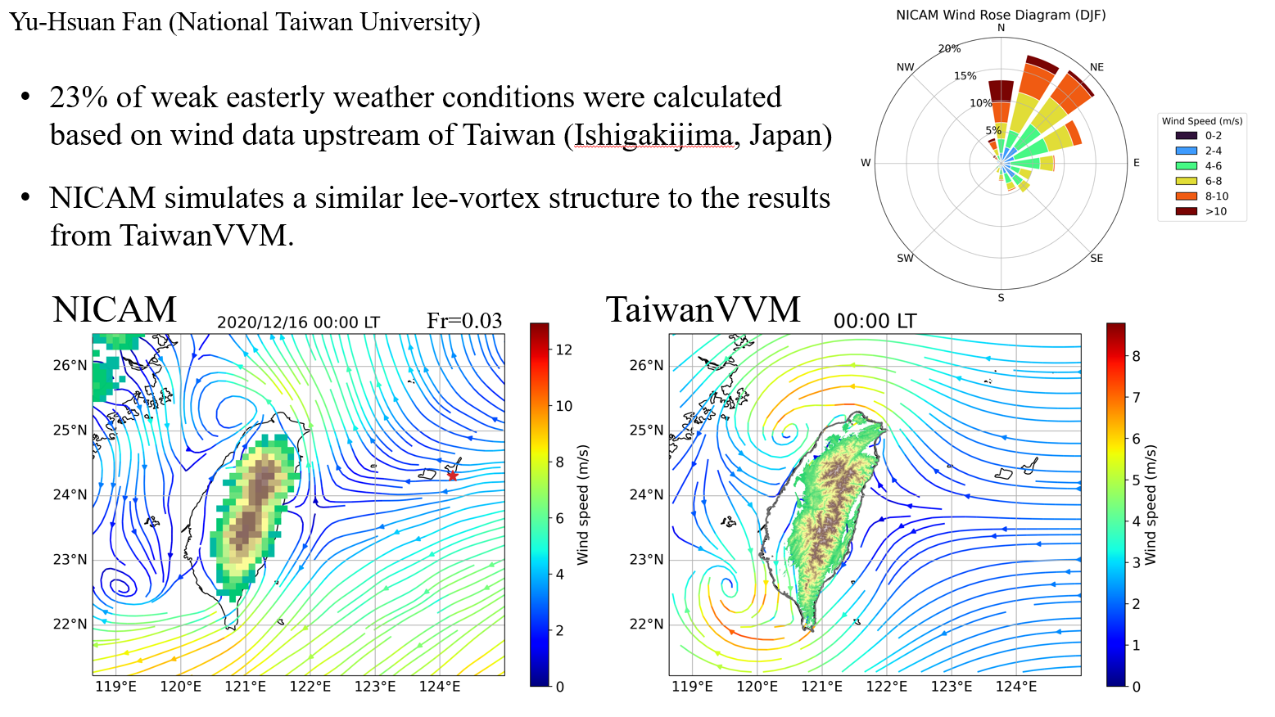

Slide 26
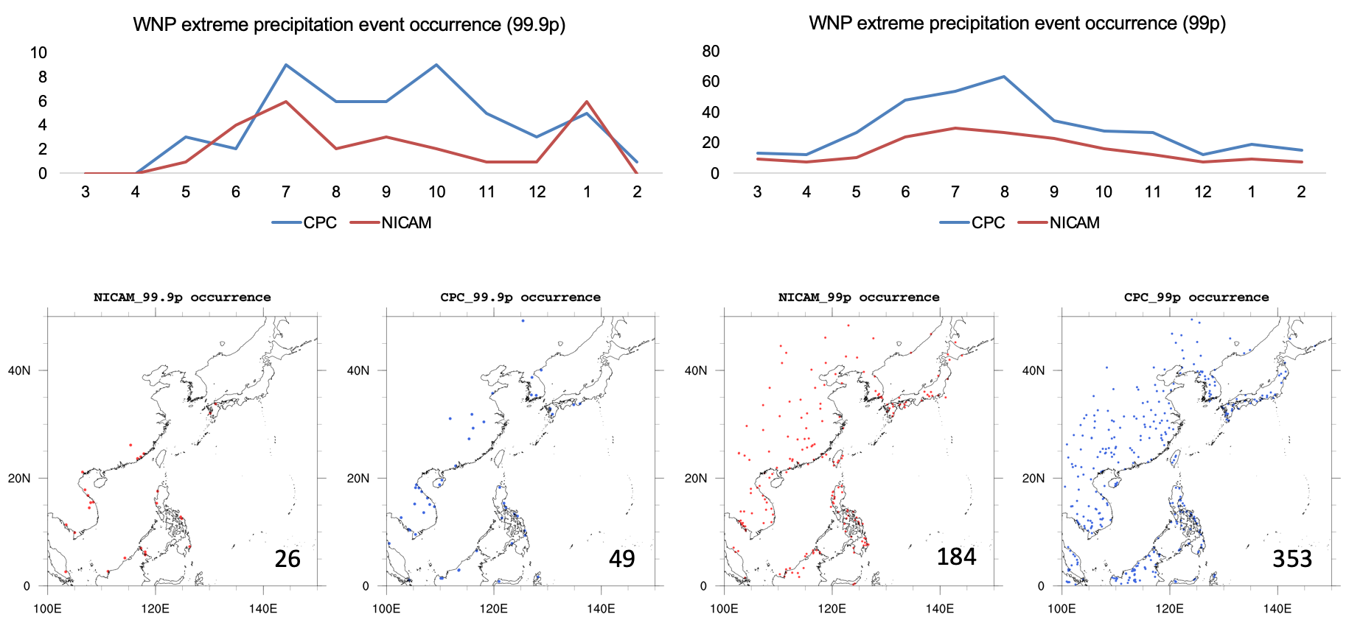
Extreme Precipitation Event Occurrence Pin-Yu Chao

Slide 27
Team Joint Report
May 13 (Tue) 2025

Slide 28
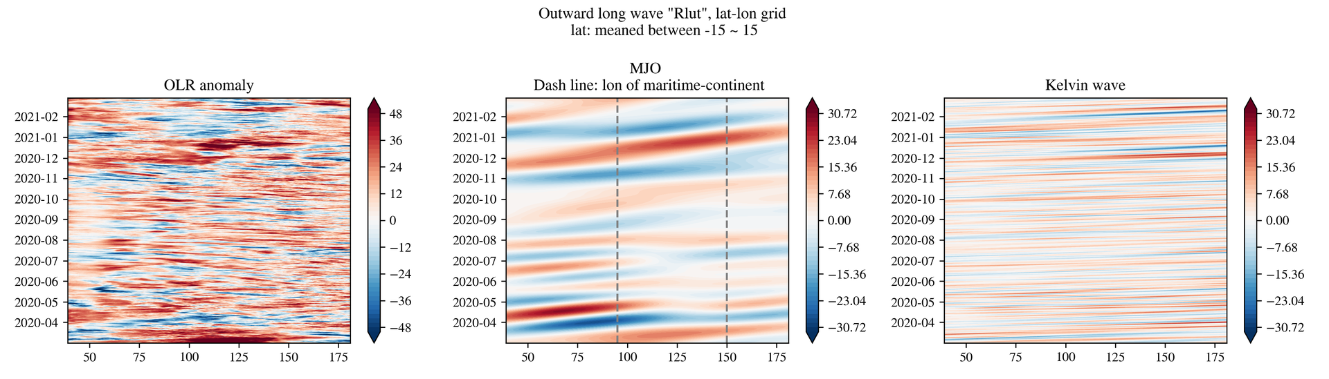
Hacking status
@raykuo
Hey guys, I (finally) plotted the hovmoller diagram of the OLR anomaly (NICAM lat-lon data, 'rlut'). The left panel is the OLR anomaly, and the middle and right panel are for MJO, Kelvin waves. These two signals are band-passed data of the OLR anomaly. We can note that the Barrier effect in the marinetime contenent is not significant in this 1-year simulation.
(5) hk25-Convorg - WCRP Lighthouse MPIM Chat Service (Mattermost)

Slide 29
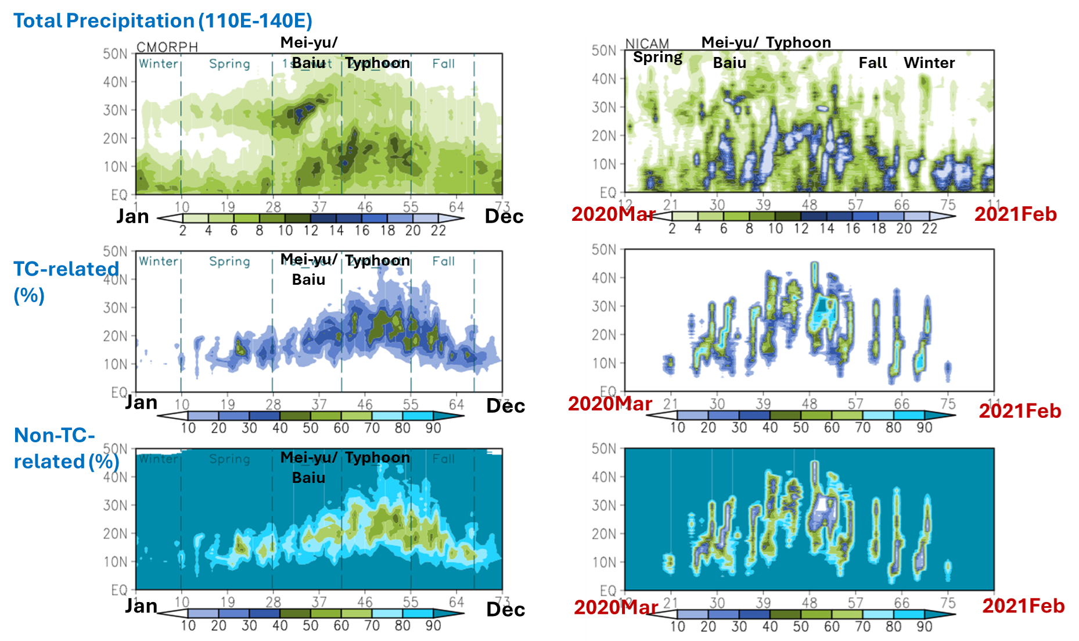
Seasonal Precipitation of the East Asian Monsoon Related to Tropical Cyclones
TC Tracking was provided by Team TC

Slide 30
Hacking issues
Calculation of length of contour lines, for fractal dimension
Some problems in Chunk? Overload of memories.
Do not use .load() and .compute()

Slide 31
Hacking issues
Calculation of length of contour lines, for fractal dimension

